Slide 1

Lecture – 12/6/2016
CSCI 36300 – Software Design

Slide 2
Course Evaluations
Course Evaluations should be available.
You should receive an email about how to complete the course evaluations.
Feedback on your TA (Zach Reynolds) is also welcome – email any comments you have regarding his performance this semester.
Course Evaluations Link:
http://coursequestionnaire.iu.edu/Blue/
Questions/Concerns/Feedback
Also, CSCI 240 feedback is greatly appreciated!

Slide 3
Assignment #5 - Feedback

Slide 4
Quiz #17 – The Last One!!!

Slide 5
Software Anti-Patterns

Slide 6
Walking through a Minefield
Numerous bugs occur in released software products.
2-5 Bugs Per LOC
Unknown Bugs
Windows Updates
Security Fixes
Known vs. Unknown
Scale & Scope
Large scale systems = catastrophic!

Slide 7
Walking through a Minefield
Formal Verification Tools
Software Testing
Phases of Testing & Quality Assurance
Code Reviews
Peer-Lead Reviews
We want to believe that things will be “good” and that we can trust software…

Slide 8
Cut-and-Paste Programming
It's easier to modify existing software than program from scratch.
Is this really the case?
Seasoned programmers know when/how to reuse code – just because something has been created doesn’t mean it is always “right.”
Common Code

Slide 9
Cut-and-Paste Programming
The same software bug reoccurs throughout software despite many local fixes.
Lines of code increase without adding to overall productivity.
It becomes difficult to locate and fix all instances of a particular mistake.
Leads to excessive software maintenance costs.

Slide 10
Cut-and-Paste Programming
Software defects are replicated through the system.
Developers create multiple unique fixes for bugs with no method of resolving the variations into a standard fix.
Deceptively inflates the number of lines of code developed without the expected reduction in maintenance costs associated with other forms of reuse.

Slide 11
Cut-and-Paste Programming
It takes a great deal of effort to create reusable code, and organization emphasizes short-term payoff more than long-term investment.
The context or intent behind a software module is not preserved along with the code.
The organization does not advocate or reward reusable components, and development speed overshadows all other evaluation factors.

Slide 12
Cut-and-Paste Programming
There is a lack of abstraction among developers, often accompanied by a poor understanding of inheritance, composition, and other development strategies.
Reusable components, once created, are not sufficiently documented or made readily available to developers.

Slide 13
Cut-and-Paste Programming
Spaghetti Code goes hand-in-hand with this software anti-pattern.
If we consistently use the same “bad” solution over and over again we should expect the same “bad” results.
Makes it difficult to trace and to properly reuse the code.
Extensions difficult because the tendency is to cut and paste the solution.

Slide 14
Mushroom Management
Blind Development
This is a symptom that can also lead to problems in personnel management.
Isolate system developers from the system's end users.
Why would you want to do this???

Slide 15
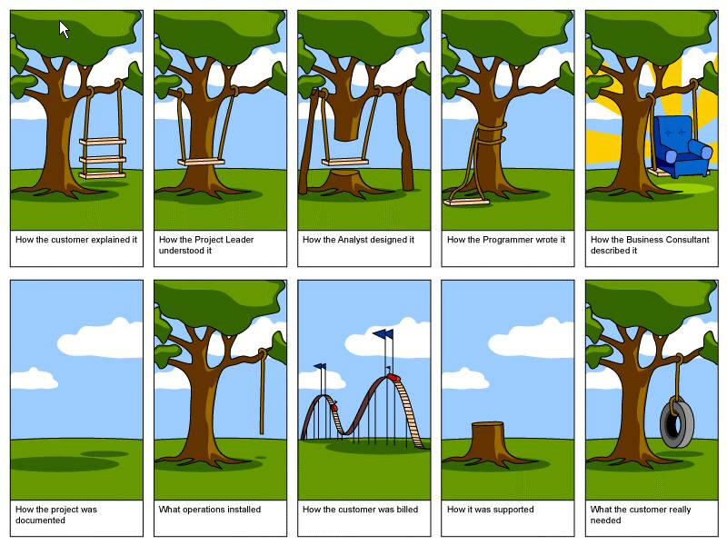
Mushroom Management

Slide 16
Mushroom Management
In reality, requirements change frequently and drive about 30 percent of development cost.
In a Mushroom Management project, these changes are not discovered until system delivery.
User acceptance is always a significant risk, which becomes critical in Mushroom Management.
Proper communication and OO understanding is key!

Slide 17
Mushroom Management
The implications of requirements documents are rarely understood by end users, who can more easily visualize the meaning of requirements when they experience a prototype user interface.
The prototype enables end users to articulate their real needs in contrast to the prototype's characteristics.

Slide 18
Mushroom Management
When developers don't understand the overall requirements of a product, they rarely understand the required component interaction and necessary interfaces.
Poor design decisions are made and often result in stovepipe components with weak interfaces that do not fulfill the functional requirements.
What is it that we are actually building?

Slide 19
Mushroom Management
Including a domain expert on the development team is a very effective way to have domain input on project decisions.
Whenever there is a domain-specific question, team members have expertise on-hand.
This helps to alleviate this problem – under the assumption that each “domain” expert is included in the discussion.

Slide 20
Refactoring
Let’s first revisit a discussion about various code smells and the impact that they have on our design:
What is code smell?
How can it be identified?
What can we do about it?

Slide 21
Code Smells
Types of code smell:
Bloaters
Object-Orientation Abusers
Change Preventers
Dispensables
Couplers
Is this a complete list?
No, there are many different “smells” that exist in code.

Slide 22
Bloaters
Bloaters are code, methods and classes that have increased to such gargantuan proportions that they are hard to work with.
Usually these smells do not crop up right away, rather they accumulate over time as the program evolves.
If left to fester on their own they can become quite a problem in a software system.

Slide 23
Object-Orientation Abusers
Incomplete or incorrect application of object-oriented programming principles.
We saw these in each of the design patterns we discussed this semester?
When/How/Why should you use ______ pattern?
Typical Occurrences:
The programmer who created one of the classes probably didn't know that a functionally equivalent class already existed.

Slide 24
Change Preventers
When you need to change something in one place in your code, you have to make many changes in other places too.
Program development becomes much more complicated and expensive as a result.
How can we alleviate this smell?
Cohesion/Coupling
Ripple or cascading effects.

Slide 25
Dispensables
Something pointless and unneeded whose absence would make the code cleaner, more efficient and easier to understand.
Duplicate Code
Code that is subject to a copy-and-paste mentality.
“Dead” Code
Code that no longer serves a purpose for the given software system.
Comments
If you feel that your code is so complex that comments are needed then you might want to look at breaking the problem down.

Slide 26
Couplers
Excessive coupling between classes.
If it doesn’t feel right, or is forced, don’t do it.
If you couple things together that don’t belong together you have just added to the complexity of the software project through an added dependency.
Middle Man
Just a delegation class that serves no real purpose.
Often this is seen in an unnecessary proxy.

Slide 27
Refactoring
Refactoring Techniques:
Composing Methods
Moving Features between Objects
Organizing Data
Simplifying Conditional Expressions
Simplifying Method Calls
Dealing with Generalization

Slide 28
Composing Methods
Excessively long methods are the root of all evil.
A method contains the logic of your code – if they are excessively long it makes it difficult to not only follow but understand the programs logic.
Break the method into separate sub-methods or helpers.
Extract the method or alter the parameters.

Slide 29
Moving Features between Objects
Safely move functionality between classes, create new classes, and hide implementation details from public access.
The goal here is to increase the cohesion of the object.
Move like-minded components together.
This sounds familiar…
Algorithm Analysis
Revisit the approach you are implementing – there may be a more efficient way of achieving your goal.

Slide 30
Organizing Data
Computer Science is all about data!
How we organize our data is important.
Move variables to create a new object.
Examine your design approach – often times you can allow real world (domain) examples to drive how you should handle and treat the data in your program.

Slide 31
Simplifying Conditional Expressions
Conditionals tend to get more and more complicated in their logic over time.
How many times have you written a group of if/else-if/else statements and you just keep adding or revisiting later to add “just one more.”
Are there better approaches?
What was the original intent of the conditional – could it be improved through splitting the logic across helper classes?

Slide 32
Simplifying Method Calls
One of the biggest flaws that you see in production code is method names that do not make sense.
W(s)
With modern languages you should be expressive in your naming conventions.
Don’t overdo it though!
Examine method parameters as well.

Slide 33
Dealing with Generalization
Abstraction
We saw this earlier this semester in the form of templates.
We could have created a separate project to handle each type that an Array could take – that would be tedious, useless, and error prone.
Inheritance Hierarchies
How do we adjust for changes in the chain of command/control in our system?

Slide 34
Overview
Software Anti-Patterns are closely related to their counter part of Software Design Patterns.
Documented ways where problems are likely to occur.
We often see this manifested through various code smells.
We can refactor our software to help remedy or eliminate these smells.
No silver bullet!

